Slide 1

Capstone Project 2
HEART DISEASE DETECTION USING CLASSIFICATION ALGORITHMS
Team Members
T170800521: Vedant Patil
T170800540: Piyush Patil
T170800517: Sankalp Patil
T170800509: Ashwin Poojary
T170800502: Nilesh Rupnawar

Slide 2
Table of Contents
Problem Statement
Overview of the Project
Data generation & Loading
Data Exploration & Understanding
Exploratory Data Analysis
Data Preprocessing & Feature Engineering
Model Building & Training
Model Evaluation & Performance Analysis
Stream API Deployment (Streamlit)
Docker Deployment
Conclusion

Slide 3
Problem Statement
Heart disease is one of the leading causes of death worldwide. Early detection is important for reducing complications and improving patient outcomes. Traditional diagnosis requires medical examinations, clinical tests, and expert interpretation. Machine learning can analyze patient health information to identify patterns associated with heart disease. This project aims to develop a classification-based system to predict the presence or absence of heart disease.

Slide 4
Overview of the Project
Develop a supervised machine learning system for heart disease classification.
Analyze patient demographic, clinical, and diagnostic information.
Implement four classification algorithms: Logistic Regression, Decision Tree, Random Forest, and Support Vector Machine.
Compare algorithms using multiple performance metrics.
Deploy the selected model through FastAPI and Docker.

Slide 5
Data generation & Loading
Dataset Name: heart_disease_dataset.csv
Total Columns: 14
Dataset Format: CSV
Target Variable: heart_disease
0 = No Heart Disease
1 = Heart Disease
Python Libraries: Pandas and NumPy for data loading and manipulation.
Total Records | Input Feature | Target Column | Missing Values
400 | 13 | Heart_disease | 0

Slide 6
Data Exploration & Understanding
Dataset Source: Heart Disease Dataset (heart_disease_dataset.csv), containing patient demographic, clinical, and diagnostic information.
Dataset Size & Target: 400 patient records with 13 input features and 1 target variable, heart_disease (0 = No Heart Disease, 1 = Heart Disease).
Key Features – Patient Information: Age, Sex, Chest Pain Type, Resting Blood Pressure, and Cholesterol.
Clinical & Diagnostic Features: Fasting Blood Sugar, Resting ECG, Maximum Heart Rate, Exercise-Induced Angina, and ST Depression.
Additional Cardiac Features: ST Slope, Number of Major Vessels, and Thalassemia.

Slide 7
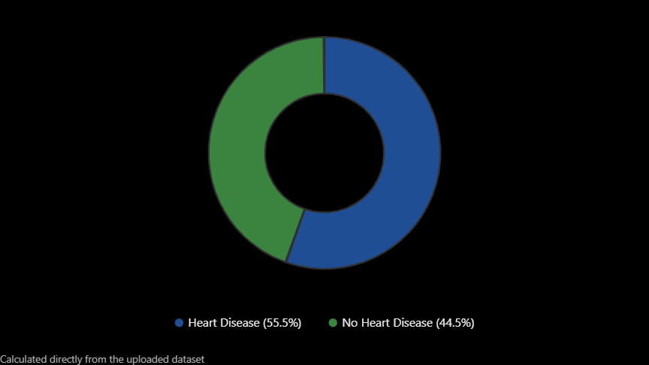
Exploratory Data Analysis
Purpose: Understand patterns, relationships, and distributions in patient health data.
Analyzed age, cholesterol, blood pressure, and maximum heart rate.
Examined the distribution of patients with and without heart disease.
Checked for missing values and duplicate records.
Explored relationships between clinical features and the target variable.
Identified features potentially useful for heart disease prediction.

Slide 8
Data Preprocessing & Feature Engineering
Missing Values: No missing values found in the dataset.
Duplicate Records: No duplicate rows detected.
Encoding: All features are already represented numerically.
Feature Selection: Use the 13 clinical attributes as input features.
Feature Scaling: Apply standardization where required, especially for Logistic Regression and SVM.
Data Splitting: Divide the dataset into training and testing subsets.
.

Slide 9
Model Building & Training
The machine learning models are developed using Python and Scikit-learn.
Training Process: Load the preprocessed dataset.
Separate input features (X) and target variable (y).
Split the dataset into training and testing sets.
Train Logistic Regression, Decision Tree, Random Forest, and SVM models.
Generate predictions using the testing dataset.
Compare results to identify the most suitable model.
Patient Dataset
Data Preprocessing
Train–Test Split
Classification Model Training
Model Evaluation
Final Model Selection

Slide 10
Model Evaluation & Performance Analysis
The trained models are evaluated using classification performance metrics. Important: Recall is particularly important because missing an actual heart disease case may have serious consequences.
Metric | Purpose
Accuracy | Measures overall correct predictions
Precision | Measures correctness of positive predictions
Recall (Sensitivity) | Measures detection of actual heart disease cases
F1-Score | Balances Precision and Recall
Specificity | Measures detection of patients without heart disease
ROC-AUC | Evaluates the ability to distinguish between classes

Slide 11
Stream API Deployment (Streamlit)
Interactive Web Interface: Develop a user-friendly application using Streamlit.
Patient Data Input: Users enter 13 clinical parameters, including age, blood pressure, cholesterol, and chest pain type.
Model Integration: Integrate the trained machine learning model with the Streamlit application.
Data Processing: Process and validate user inputs before passing them to the model.
Real-Time Prediction: Predict whether heart disease is present or absent.
Result Visualization: Display prediction results clearly on the web interface.

Slide 12
Docker Deployment
Purpose: Package the prediction API and its dependencies into a portable container.
                Create a Dockerfile for the application.
                Include Python, required libraries, and the trained model.
                Build a Docker image containing the FastAPI application.
                Run the application inside a Docker container.
                Access the prediction API through an exposed port.
Benefits:
Consistent execution environment
Easy application deployment
Portability across different systems
Simplified dependency management

Slide 13
Conclusion
Explored a heart disease dataset containing 400 patient records and 13 clinical features. Established a workflow for data preprocessing, classification, and model evaluation. Selected four supervised learning algorithms for comparison. Designed a prediction workflow to support early heart disease risk identification. Proposed deployment using FastAPI and Docker.

Slide 14
Any Queries ???

